Slide 1

DISCLAIMER
The information in this presentation is provided to you by PT. AXAR Technology Raya, solely for informational purposes and does not constitute an offer to buy, sell or issue, or a solicitation of an offer to sell, buy or acquire any securities of the Company in any jurisdiction or an inducement to enter into investment activity, nor may it or any part of it form the basis of or be relied on in connection with any contract or commitment whatsoever. No representations or warranties, express or implied, are made by the Company, any underwriters, any of their respective affiliates, directors, officers, employees, advisors or representatives with respect to, and no reliance should be placed, on the accuracy, fairness or completeness of the information presented or contained in this presentation. By viewing this presentation, you agree that none of the Company, any underwriters, nor any of their respective affiliates, directors, officers, employees, advisors or representatives accepts any responsibility or liability whatsoever for any loss howsoever arising from any information presented or contained in or derived from or omitted from this presentation. The information presented or contained in this presentation was obtained from various sources, including certain third parties, and has not been independently verified, and its accuracy is not guaranteed.
This presentation does not contain all relevant information relating to the Company or its securities, particularly with respect to the risks and special considerations involved with an investment in the securities of the Company. These materials are not an offer of securities for sale. Any public offering will be made by means of a prospectus that may be obtained from the issuer and that will contain detailed information about the company and management, as well as financial statements. This presentation speaks as of its date and the information presented or contained in this presentation is subject to change without notice or update.
This presentation contains statements that constitute forward-looking statements. These statements include descriptions regarding the intent, belief or current expectations of the Company or its officers about the future. These statements can be recognized by the use of words such as “expects,” “plans,” “will,” “estimates,” “projects,” “intends,” or words of similar meaning. Such forward-looking statements are not guarantees of future performance and involve risks and uncertainties, and actual results may differ from those in the forward-looking statements as a result of various factors and assumptions, many of which are beyond the Company’s control. The Company or any of its affiliates, advisors, representatives or underwriters has no obligation and does not undertake to revise forward-looking statements to reflect future events or circumstances.
THE INFORMATION CONTAINED IN THIS DOCUMENT IS HIGHLY CONFIDENTIAL AND MAY NOT BE FORWARDED, PUBLISHED OR DISTRIBUTED, DIRECTLY OR INDIRECTLY, TO ANY OTHER PERSON (WHETHER WITHIN OR OUTSIDE YOUR ORGANIZATION/FIRM) FOR ANY PURPOSE AND MAY NOT BE REPRODUCED IN ANY MANNER WHATSOEVER. ANY FORWARDING, PUBLICATION, DISTRIBUTION OR REPRODUCTION OF THIS DOCUMENT IN WHOLE OR IN PART IS UNAUTHORIZED.
MOBILE
DEVELOPMENT
DAY 4

Slide 2
OBJECTIVES
Generics
Lists
Sets
Maps
Notes:
Save Time....:
The Platform will house/aggregate thousands of DIRECT SUPPLIERS. Buyer members are now abled to easily Pick whats best suitable for them.
Discover...:
Suppliers need to be a registered and verified members. There will be features such as ratings and certifications to boost further.
Grow Business:
Members akan di-empowered dengan sebuah tool digital yang yang tadinya menyerang industri, malah justru membuat mereka bisa menjadi lebih kompetitif di era digital.

Slide 3
Generics
Dalam membuat sebuah aplikasi, terkadang kita memerlukan banyak class atau method yang serupa namun diperuntukkan untuk berbagai tipe/class. Hal ini dapat menyebabkan kita membuat banyak sekali kodingan yang tidak perlu dan akhirnya repot dalam mengembangkan atau me-maintain kodingan kita tersebut.
Contoh :
Data yang diterima response API,
Generic Type (T) dapat menyelesaikan masalah tersebut.
Notes:
Save Time....:
The Platform will house/aggregate thousands of DIRECT SUPPLIERS. Buyer members are now abled to easily Pick whats best suitable for them.
Discover...:
Suppliers need to be a registered and verified members. There will be features such as ratings and certifications to boost further.
Grow Business:
Members akan di-empowered dengan sebuah tool digital yang yang tadinya menyerang industri, malah justru membuat mereka bisa menjadi lebih kompetitif di era digital.

Slide 4
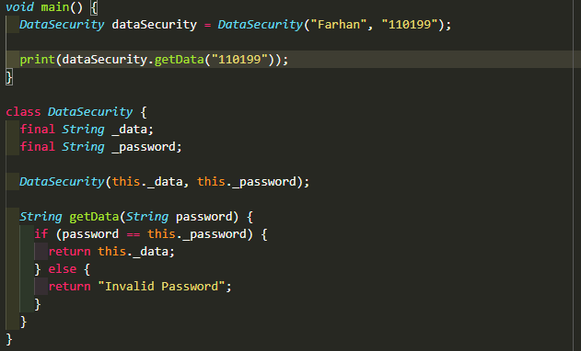
Generics
Contoh 1.
Buat program yang dapat mengakses data string dengan suatu password. Data akan ditampilkan jika password benar.
Bagaimana jika data yang
akan diaskses adalah integer ?
Notes:
Save Time....:
The Platform will house/aggregate thousands of DIRECT SUPPLIERS. Buyer members are now abled to easily Pick whats best suitable for them.
Discover...:
Suppliers need to be a registered and verified members. There will be features such as ratings and certifications to boost further.
Grow Business:
Members akan di-empowered dengan sebuah tool digital yang yang tadinya menyerang industri, malah justru membuat mereka bisa menjadi lebih kompetitif di era digital.

Slide 5
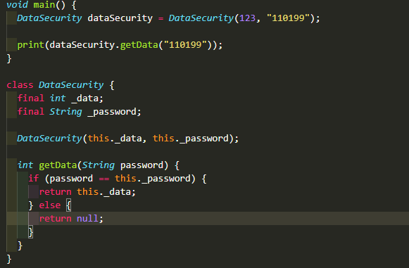
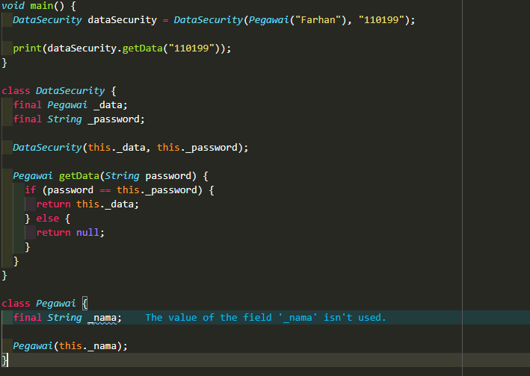
Generics
Contoh 1.
Jika data yang diakses adalah integer Jikada yang diakses adalah object ?
Notes:
Save Time....:
The Platform will house/aggregate thousands of DIRECT SUPPLIERS. Buyer members are now abled to easily Pick whats best suitable for them.
Discover...:
Suppliers need to be a registered and verified members. There will be features such as ratings and certifications to boost further.
Grow Business:
Members akan di-empowered dengan sebuah tool digital yang yang tadinya menyerang industri, malah justru membuat mereka bisa menjadi lebih kompetitif di era digital.

Slide 6
Generics
Bagaimana jika data yang harus diamankan sangat banyak, tentunya akan sangat menyusahkan developer jika harus mengimplementasikan kelas pada setiap data yang akan digunakan.
Hal tersebut dapat diselesaikan dengan generic type <T>.
Syntax :
class Nama_kelas <T> {
}
Notes:
Save Time....:
The Platform will house/aggregate thousands of DIRECT SUPPLIERS. Buyer members are now abled to easily Pick whats best suitable for them.
Discover...:
Suppliers need to be a registered and verified members. There will be features such as ratings and certifications to boost further.
Grow Business:
Members akan di-empowered dengan sebuah tool digital yang yang tadinya menyerang industri, malah justru membuat mereka bisa menjadi lebih kompetitif di era digital.

Slide 7
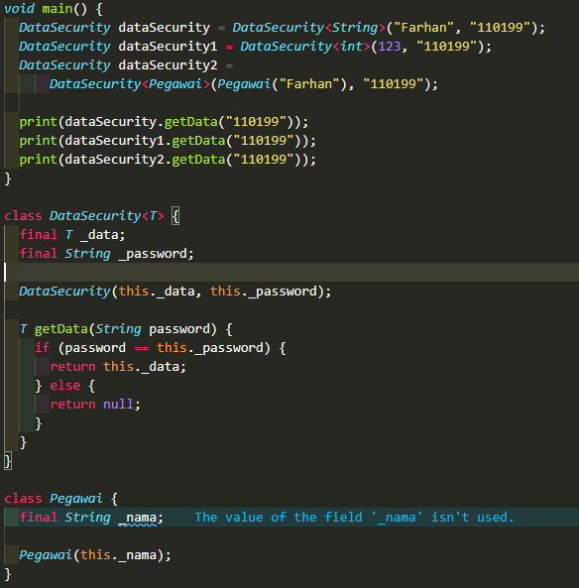

Generics
Solusi penyelesaian pada masalah sebelumnya.
Dengan desain kelas DataSecurity seperti disamping maka kelas DataSecurity dapat menerima tipe data apa saja. Contoh pada program disamping kelas DataSecurity dapat menerima tipe data String, int, dan object Pegawai. Berikut adalah output dari program disamping :
Notes:
Save Time....:
The Platform will house/aggregate thousands of DIRECT SUPPLIERS. Buyer members are now abled to easily Pick whats best suitable for them.
Discover...:
Suppliers need to be a registered and verified members. There will be features such as ratings and certifications to boost further.
Grow Business:
Members akan di-empowered dengan sebuah tool digital yang yang tadinya menyerang industri, malah justru membuat mereka bisa menjadi lebih kompetitif di era digital.

Slide 8
Lists
List adalah sekelompok objek yang diurutkan. Library dart: core menyediakan kelas List yang memungkinkan pembuatan dan manipulasi isi dari list tersebut. Index merupakan pengidentifikasi urutan pada list. Index dihitung dari 0.
Contoh. [senin, selasa, rabu, kamis, jumat, sabtu, minggu]
index ke-0 adalah senin
index ke-1 adalah selasa, dst
List terbagi menjadi 2 :
Fix Length (panjang/jumlah anggota list sudah tetap)
Growable (panjang/jumlah anggota list dapat berubah)
Berikut ini adalah syntax pembutan Fix Length List :
List<tipe_data> nama_list = List<tipe_data>(panjang_list);
Berikut ini adalah syntax untuk inisialisasi nilai list :
nama_list [index] = value;
Notes:
Save Time....:
The Platform will house/aggregate thousands of DIRECT SUPPLIERS. Buyer members are now abled to easily Pick whats best suitable for them.
Discover...:
Suppliers need to be a registered and verified members. There will be features such as ratings and certifications to boost further.
Grow Business:
Members akan di-empowered dengan sebuah tool digital yang yang tadinya menyerang industri, malah justru membuat mereka bisa menjadi lebih kompetitif di era digital.

Slide 9
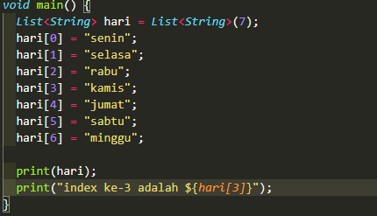

List
Contoh implementasi List
Notes:
Save Time....:
The Platform will house/aggregate thousands of DIRECT SUPPLIERS. Buyer members are now abled to easily Pick whats best suitable for them.
Discover...:
Suppliers need to be a registered and verified members. There will be features such as ratings and certifications to boost further.
Grow Business:
Members akan di-empowered dengan sebuah tool digital yang yang tadinya menyerang industri, malah justru membuat mereka bisa menjadi lebih kompetitif di era digital.

Slide 10
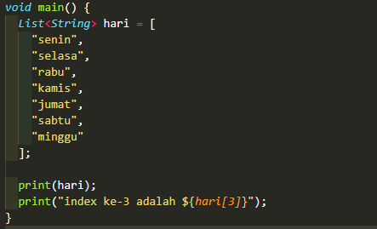
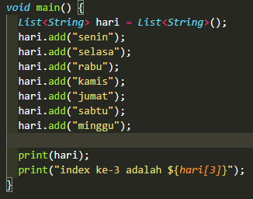
List
Berikut ini adalah syntax growable list :
List<tipe_data> nama_list = List<tipe_data>();
atau
List<tipe_data> nama_list = [ ]
Berikut ini adalah syntax untuk inisialisasi nilai list :
nama_list [index] = value;
untuk menambah anggota liat dapat menggunakan methods add(value) dan menghapus anggota dapat menggunakan methods remove(value).
Notes:
Save Time....:
The Platform will house/aggregate thousands of DIRECT SUPPLIERS. Buyer members are now abled to easily Pick whats best suitable for them.
Discover...:
Suppliers need to be a registered and verified members. There will be features such as ratings and certifications to boost further.
Grow Business:
Members akan di-empowered dengan sebuah tool digital yang yang tadinya menyerang industri, malah justru membuat mereka bisa menjadi lebih kompetitif di era digital.

Slide 11
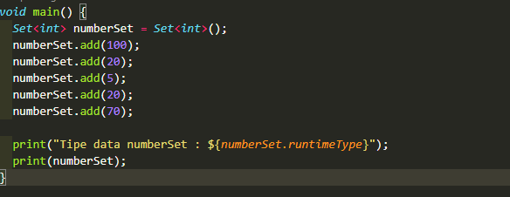

Sets
Sets merupakan sekumpulan object sejenis yang unik.
syntax :
Set<tipe_data> nama_set = Set<tipe_data>();
Pada program disamping dapat dilihat bahwa nilai 20 ditambahkan sebanyak 2 kali. Namun output hanya menulis nilai 20 sebanyak 1 kali. Hal tersebut disebabkan oleh set yang memiliki nilai unik sehingga jika ada nilai yang sama yang ditambahkan akan dihapus.
Notes:
Save Time....:
The Platform will house/aggregate thousands of DIRECT SUPPLIERS. Buyer members are now abled to easily Pick whats best suitable for them.
Discover...:
Suppliers need to be a registered and verified members. There will be features such as ratings and certifications to boost further.
Grow Business:
Members akan di-empowered dengan sebuah tool digital yang yang tadinya menyerang industri, malah justru membuat mereka bisa menjadi lebih kompetitif di era digital.

Slide 12
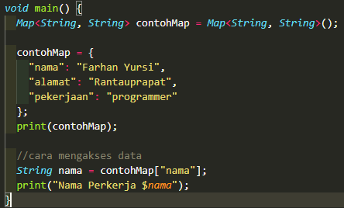

maps
Map merupakan sekumpulan object yang dimana setiap object dalam kumpulan tersebut miliki kunci (key) yang unik.
syntax :
deklarasi : Map <Key_type, value_type> nama_map = {key1 : value1, key2 :value2, dst}
Inisiasi : nama_map[ key ] = value
Pada program disamping dapat dilihat bahwa variabel nama diberi nilai dengan mengakses salah satu data maps dengan key “nama”.
Notes:
Save Time....:
The Platform will house/aggregate thousands of DIRECT SUPPLIERS. Buyer members are now abled to easily Pick whats best suitable for them.
Discover...:
Suppliers need to be a registered and verified members. There will be features such as ratings and certifications to boost further.
Grow Business:
Members akan di-empowered dengan sebuah tool digital yang yang tadinya menyerang industri, malah justru membuat mereka bisa menjadi lebih kompetitif di era digital.

Slide 13
DISCLAIMER
The information in this presentation is provided to you by PT. AXAR Technology Raya, solely for informational purposes and does not constitute an offer to buy, sell or issue, or a solicitation of an offer to sell, buy or acquire any securities of the Company in any jurisdiction or an inducement to enter into investment activity, nor may it or any part of it form the basis of or be relied on in connection with any contract or commitment whatsoever. No representations or warranties, express or implied, are made by the Company, any underwriters, any of their respective affiliates, directors, officers, employees, advisors or representatives with respect to, and no reliance should be placed, on the accuracy, fairness or completeness of the information presented or contained in this presentation. By viewing this presentation, you agree that none of the Company, any underwriters, nor any of their respective affiliates, directors, officers, employees, advisors or representatives accepts any responsibility or liability whatsoever for any loss howsoever arising from any information presented or contained in or derived from or omitted from this presentation. The information presented or contained in this presentation was obtained from various sources, including certain third parties, and has not been independently verified, and its accuracy is not guaranteed.
This presentation does not contain all relevant information relating to the Company or its securities, particularly with respect to the risks and special considerations involved with an investment in the securities of the Company. These materials are not an offer of securities for sale. Any public offering will be made by means of a prospectus that may be obtained from the issuer and that will contain detailed information about the company and management, as well as financial statements. This presentation speaks as of its date and the information presented or contained in this presentation is subject to change without notice or update.
This presentation contains statements that constitute forward-looking statements. These statements include descriptions regarding the intent, belief or current expectations of the Company or its officers about the future. These statements can be recognized by the use of words such as “expects,” “plans,” “will,” “estimates,” “projects,” “intends,” or words of similar meaning. Such forward-looking statements are not guarantees of future performance and involve risks and uncertainties, and actual results may differ from those in the forward-looking statements as a result of various factors and assumptions, many of which are beyond the Company’s control. The Company or any of its affiliates, advisors, representatives or underwriters has no obligation and does not undertake to revise forward-looking statements to reflect future events or circumstances.
THE INFORMATION CONTAINED IN THIS DOCUMENT IS HIGHLY CONFIDENTIAL AND MAY NOT BE FORWARDED, PUBLISHED OR DISTRIBUTED, DIRECTLY OR INDIRECTLY, TO ANY OTHER PERSON (WHETHER WITHIN OR OUTSIDE YOUR ORGANIZATION/FIRM) FOR ANY PURPOSE AND MAY NOT BE REPRODUCED IN ANY MANNER WHATSOEVER. ANY FORWARDING, PUBLICATION, DISTRIBUTION OR REPRODUCTION OF THIS DOCUMENT IN WHOLE OR IN PART IS UNAUTHORIZED.
THANK YOU

